Slide 1
Topic Modeling
Peitian Zhang
Renmin University of China
Currently @ MSRA Social Computing

Slide 2
Outline
Overview
Math Fundations
Datasets
Metrics
Traditional Methods
Neural Methods
Bert-based Methods

Slide 3
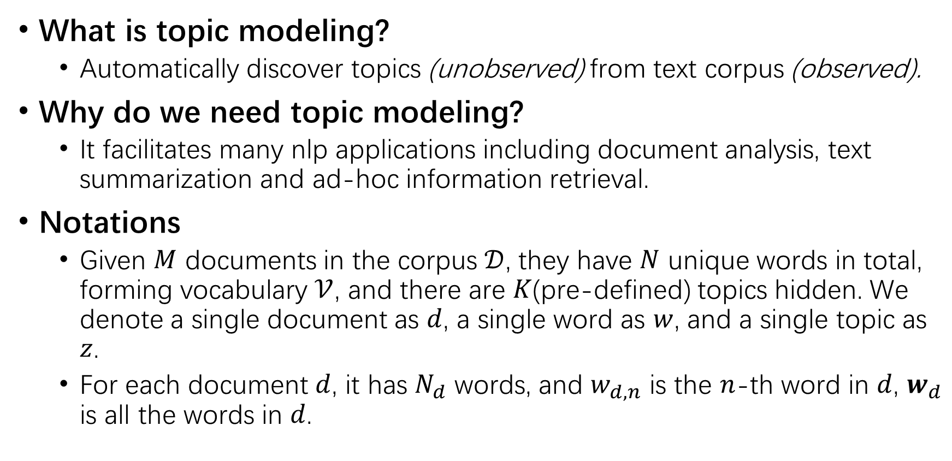
Overview
What is topic modeling?
Automatically discover topics (unobserved) from text corpus (observed).
Why do we need topic modeling?
It facilitates many nlp applications including document analysis, text summarization and ad-hoc information retrieval.
Notations
Given $M$ documents in the corpus $𝒟$, they have $N$ unique words in total, forming vocabulary $𝒱$, and there are $K$(pre-defined) topics hidden. We denote a single document as $d$, a single word as $w$, and a single topic as $z$.
For each document $d$, it has $N_{d}$ words, and $w_{d,n}$ is the $n$-th word in $d$, $w_{d}$ is all the words in $d$.

Slide 4
Datasets
20Newsgroups
A collection of approximately 20,000 annotated articles, partitioned evenly across 20 different topics.
NYTimes
A collection of 180000 news articles published between 1987 and 2007.
Yelp
The Yelp Review Challenge dataset.
Different papers use different preprocessing methods to filter out some documents or words. Traditional methods restricts the vocabulary size to guarantee performance.

Slide 5
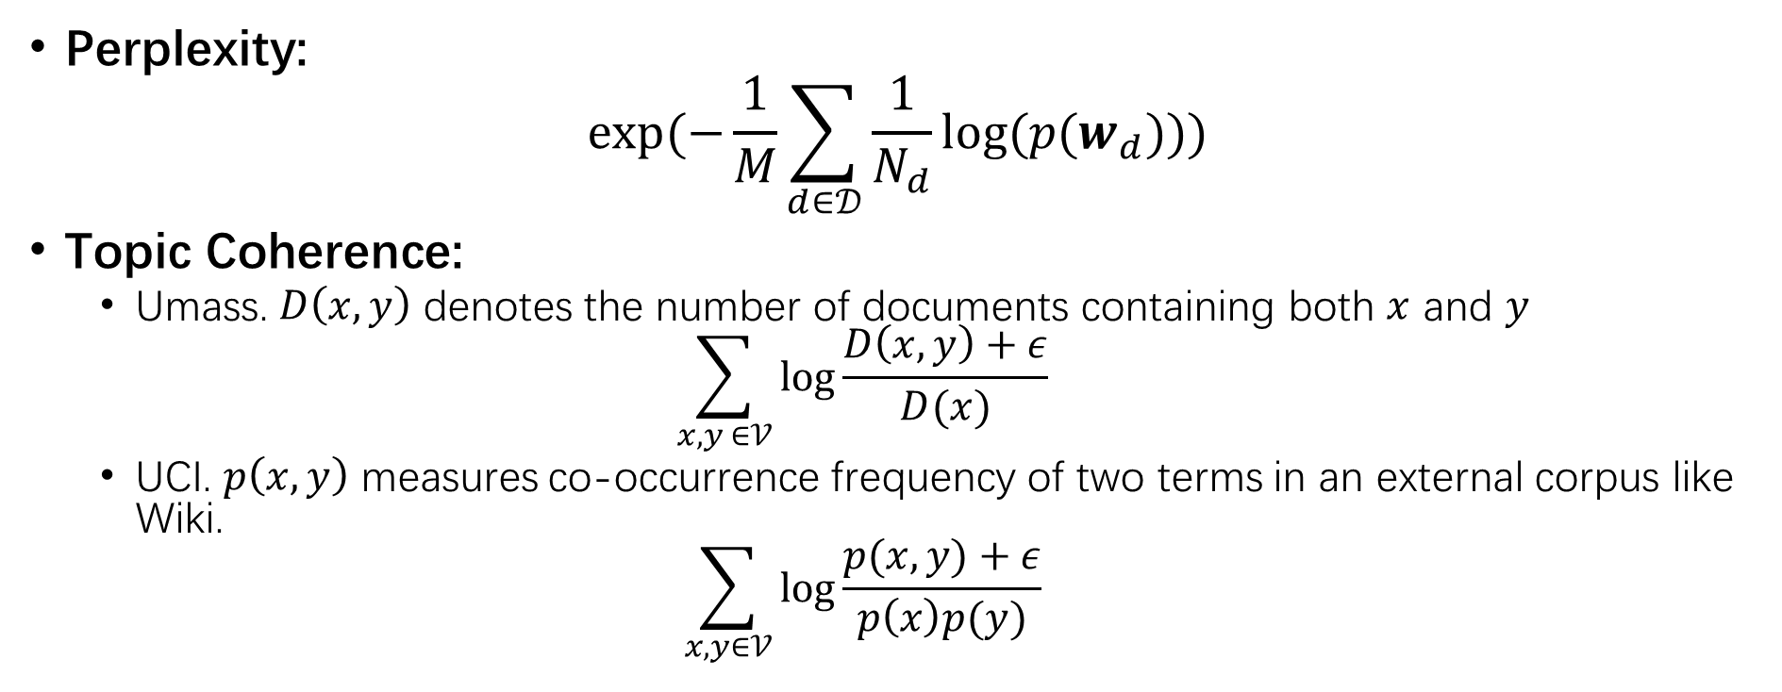
Metrics
Perplexity:
$$exp⁡(−\frac{1}{M}\sum_{d∈𝒟}{\frac{1}{N_{d}}log⁡(p(w_{d}))})$$
Topic Coherence:
Umass. $D\left(x,y\right)$ denotes the number of documents containing both $x$ and $y$
$$\sum_{x,y ∈𝒱}{\log{\frac{D\left(x,y\right)+ε}{D(x)}}}$$
UCI. $p\left(x,y\right)$ measures co-occurrence frequency of two terms in an external corpus like Wiki.
$$\sum_{x,y∈𝒱}{\log{\frac{p(x,y)+ε}{p\left(x\right)p(y)}}}$$

Slide 6
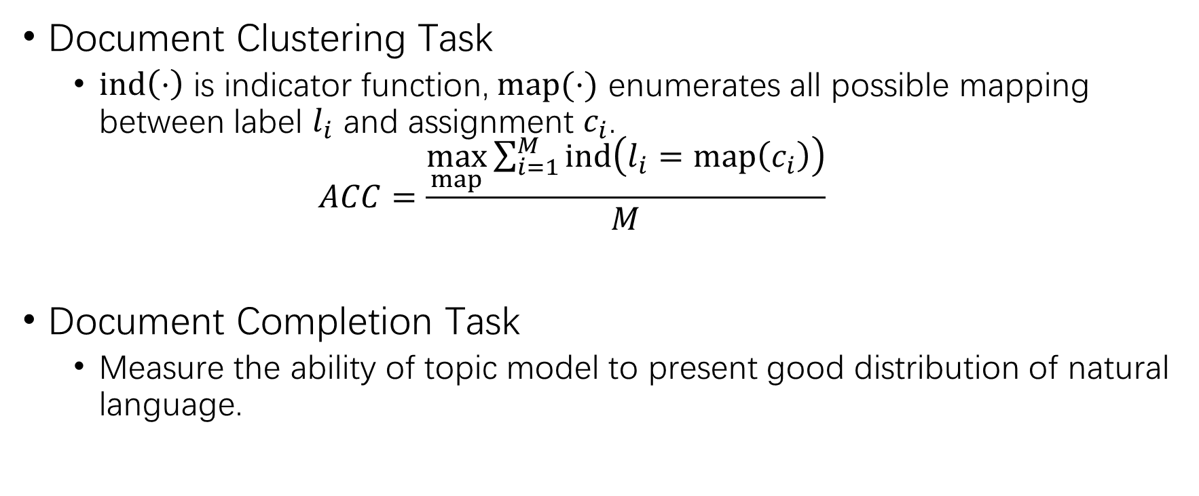
Metrics
Document Clustering Task
$ind\left(⋅\right)$ is indicator function, $map(⋅)$ enumerates all possible mapping between label $l_{i}$ and assignment $c_{i}$.
$$ACC=\frac{\max_{map}{\sum_{i=1}^{M}{ind\left(l_{i}=map\left(c_{i}\right)\right)}}}{M}$$
Document Completion Task
Measure the ability of topic model to present good distribution of natural language.

Slide 7
Traditional Methods
Resort to analytic solutions;
Difficult math;

Slide 8
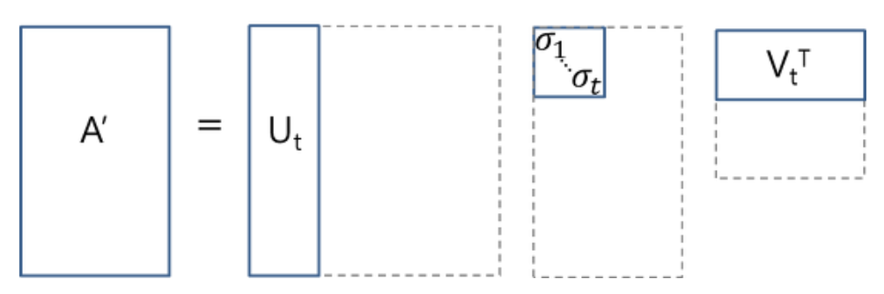
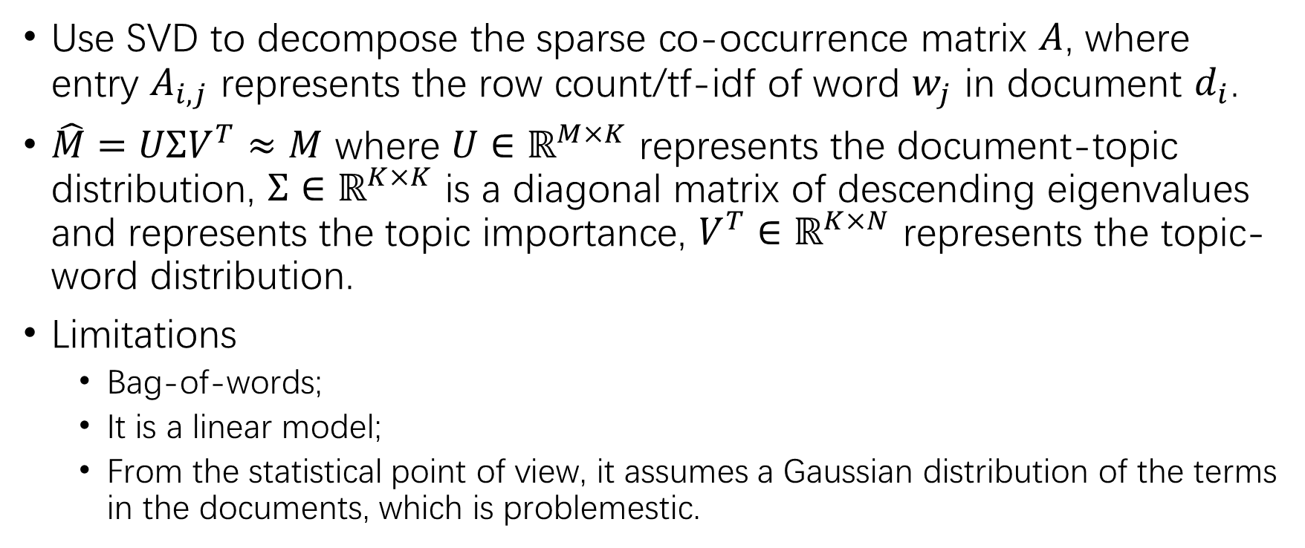
LSA
Use SVD to decompose the sparse co-occurrence matrix $A$, where entry $A_{i,j}$ represents the row count/tf-idf of word $w_{j}$ in document $d_{i}$.
$\hat{M}=UΣV^{T}≈M$ where $U∈ℝ^{M×K}$ represents the document-topic distribution, $Σ∈ℝ^{K×K}$ is a diagonal matrix of descending eigenvalues and represents the topic importance, $V^{T}∈ℝ^{K×N}$ represents the topic-word distribution.
Limitations
Bag-of-words;
It is a linear model;
From the statistical point of view, it assumes a Gaussian distribution of the terms in the documents, which is problemestic.

Slide 9
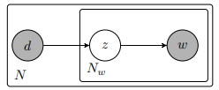
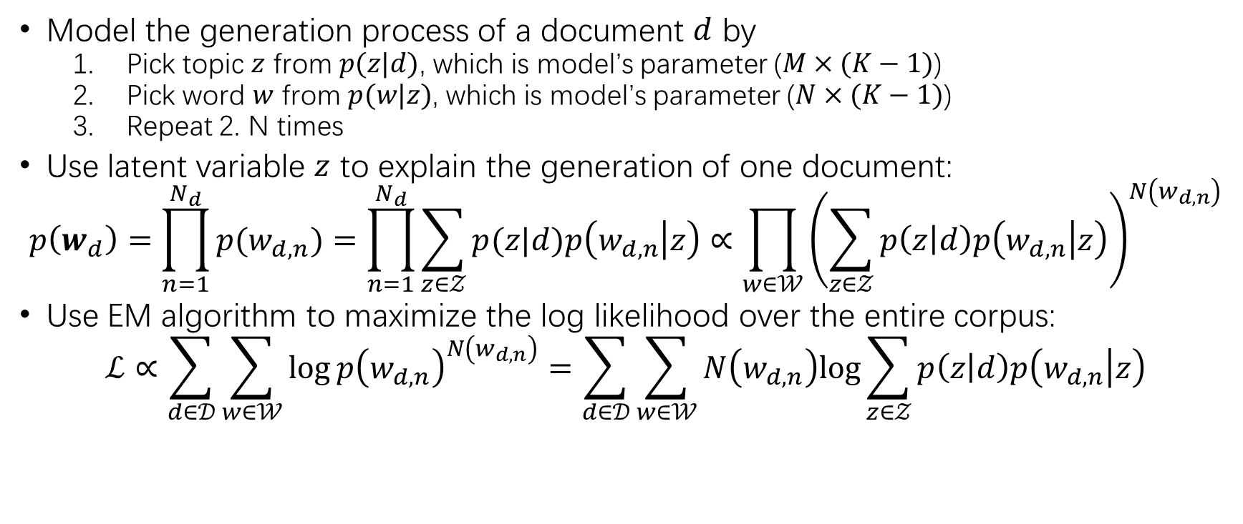
PLSA
Model the generation process of a document $d$ by
Pick topic $z$ from $p(z|d)$, which is model’s parameter ($M×(K−1)$)
Pick word $w$ from $p(w|z)$, which is model’s parameter ($N×(K−1)$)
Repeat 2. N times
Use latent variable $z$ to explain the generation of one document:
$$p\left(w_{d}\right)=\prod_{n=1}^{N_{d}}{p(w_{d,n})}=\prod_{n=1}^{N_{d}}{\sum_{z∈𝒵}{p(z|d)p\left(w_{d,n} | z\right)}}∝\prod_{w∈𝒲}{{\left(\sum_{z∈𝒵}{p\left(z | d\right)p\left(w_{d,n} | z\right)}\right)}^{N\left(w_{d,n}\right)}}$$
Use EM algorithm to maximize the log likelihood over the entire corpus:
$$ℒ∝\sum_{d∈𝒟}{\sum_{w∈𝒲}{\log{p{\left(w_{d,n}\right)}^{N\left(w_{d,n}\right)}}=\sum_{d∈𝒟}{\sum_{w∈𝒲}{N\left(w_{d,n}\right)log{\sum_{z∈𝒵}{p\left(z | d\right)p\left(w_{d,n} | z\right)}}}}}}$$

Slide 10
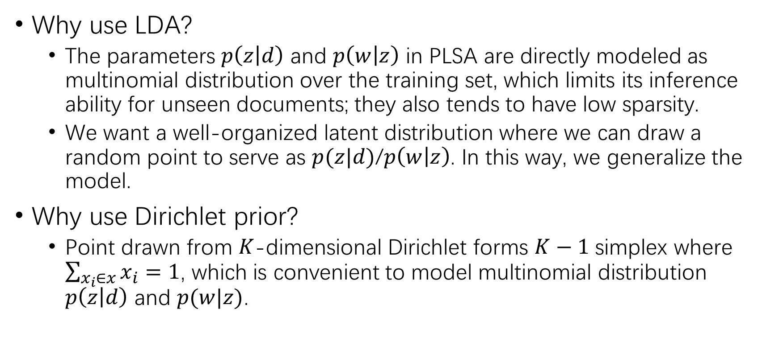
LDA
Why use LDA?
The parameters $p\left(z | d\right)$ and $p\left(w | z\right)$ in PLSA are directly modeled as multinomial distribution over the training set, which limits its inference ability for unseen documents; they also tends to have low sparsity.
We want a well-organized latent distribution where we can draw a random point to serve as $p(z|d)$/$p\left(w | z\right)$. In this way, we generalize the model.
Why use Dirichlet prior?
Point drawn from $K$-dimensional Dirichlet forms $K−1$ simplex where $\sum_{x_{i}∈x}{x_{i}}=1$, which is convenient to model multinomial distribution $p\left(z | d\right)$ and $p(w|z)$.

Slide 11
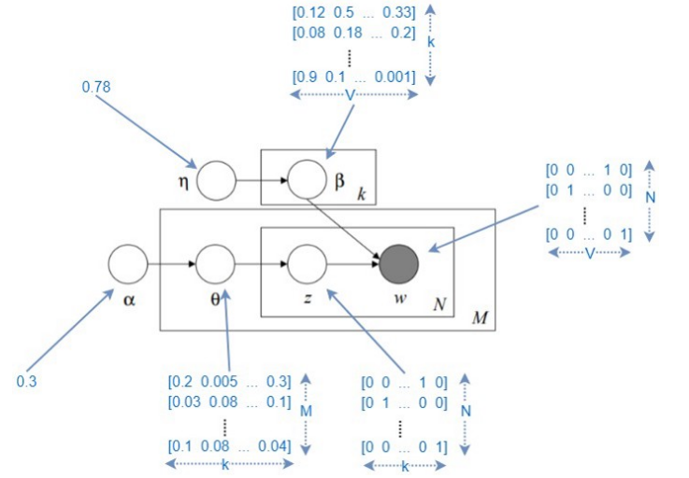
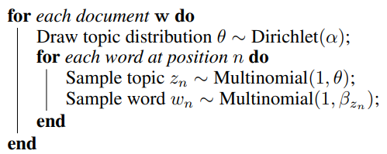
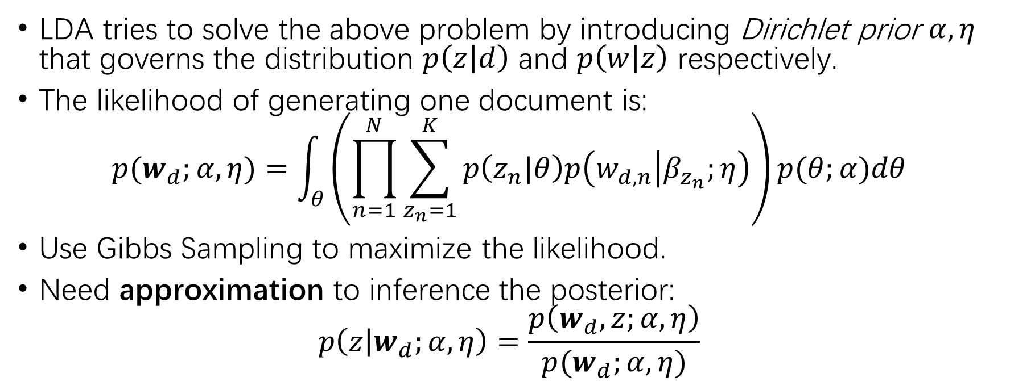
LDA
LDA tries to solve the above problem by introducing Dirichlet prior $α,η$ that governs the distribution $p\left(z | d\right)$ and $p\left(w | z\right)$ respectively.
The likelihood of generating one document is:
$$p(w_{d};α, η)=\int_{θ}{\left(\prod_{n=1}^{N}{\sum_{z_{n}=1}^{K}{p\left(z_{n}|θ\right)p\left(w_{d,n} | β_{z_{n}};η\right)}}\right)p(θ;α)dθ}$$
Use Gibbs Sampling to maximize the likelihood.
Need approximation to inference the posterior:
$$p\left(z | w_{d};α,η\right)=\frac{p\left(w_{d},z;α,η\right)}{p(w_{d};α,η)}$$

Slide 12
Neural Methods
Aims:
Solve the intractable posterior of LDA
Combine word relatedness(embedding) to Topic Modeling
Methods
Use neural networks as black box to inference posterior
Variational Inference
GAN encoder
Involve word embedding in forming the latent topic distribution

Slide 13
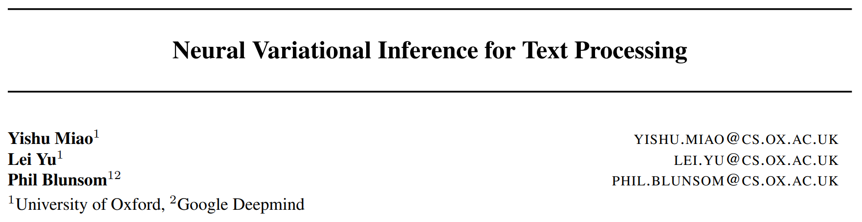
Variational Inference
ICML 2016

Slide 14
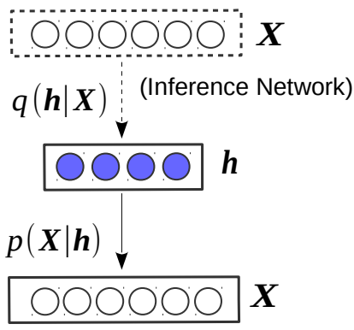
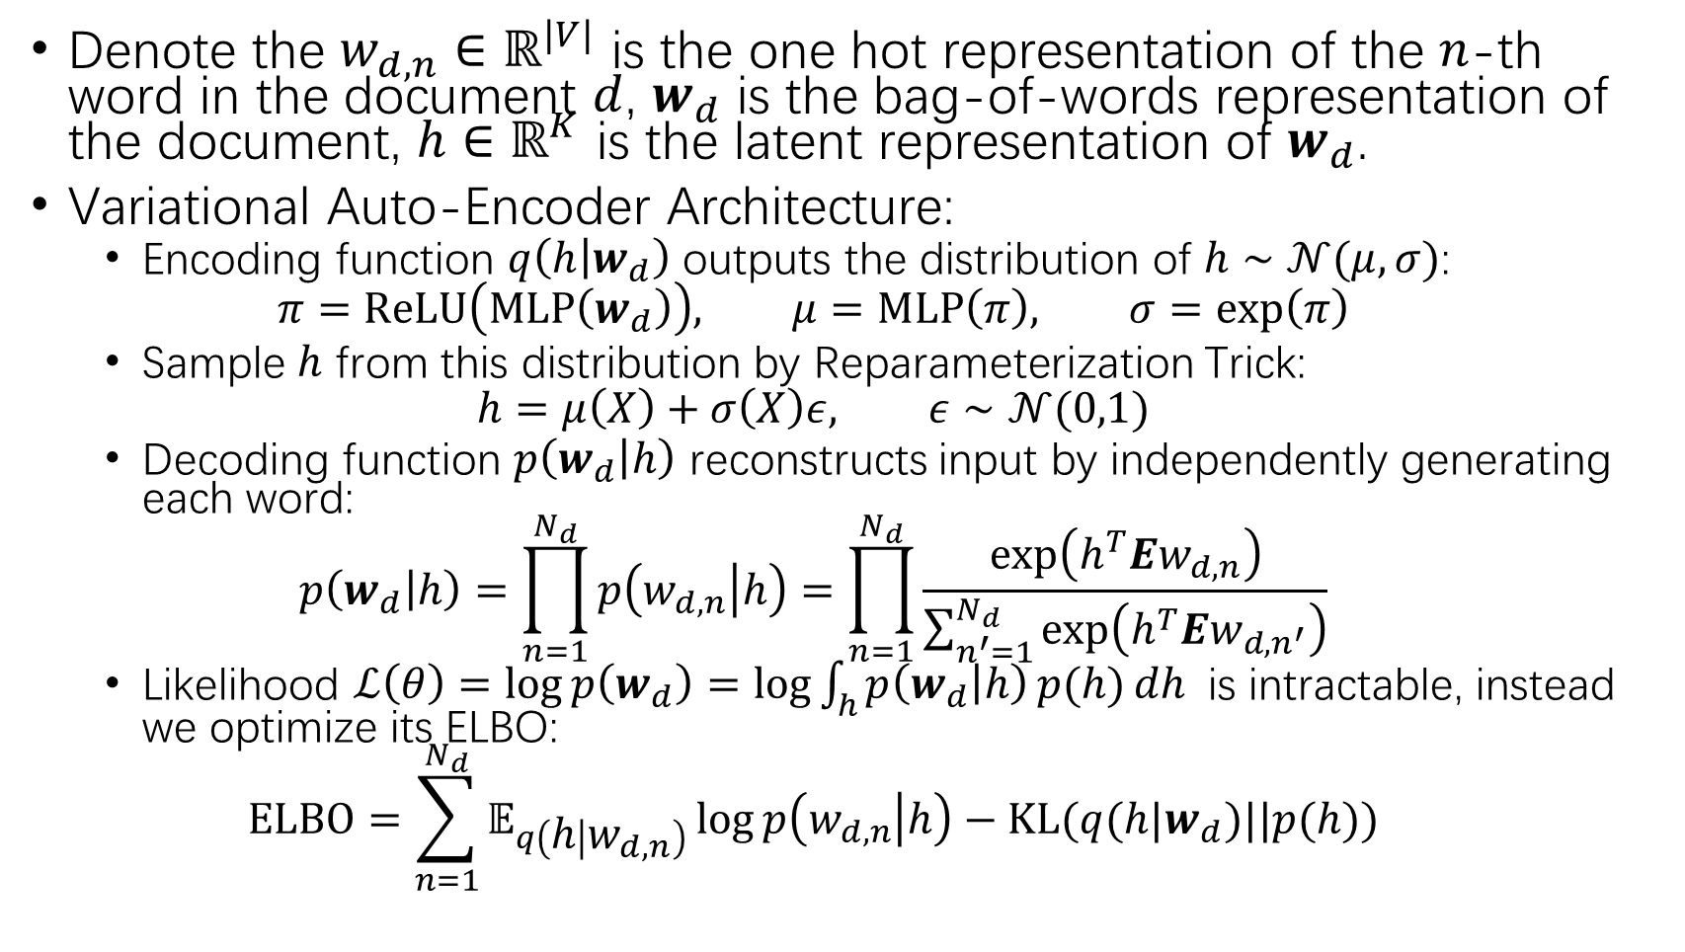
Denote the $w_{d,n}∈ℝ^{|V|}$ is the one hot representation of the $n$-th word in the document $d$, $w_{d}$ is the bag-of-words representation of the document, $h∈ℝ^{K}$ is the latent representation of $w_{d}$.
Variational Auto-Encoder Architecture:
Encoding function $q\left(h | w_{d}\right)$ outputs the distribution of $h∼𝒩(μ,σ)$:
$$π=ReLU\left(MLP\left(w_{d}\right)\right), μ=MLP\left(π\right), σ=\exp\left(π\right)$$
Sample $h$ from this distribution by Reparameterization Trick:
$$h=μ\left(X\right)+σ\left(X\right)ε, ε∼𝒩(0,1)$$
Decoding function $p\left(w_{d} | h\right)$ reconstructs input by independently generating each word:
$$p\left(w_{d} | h\right)=\prod_{n=1}^{N_{d}}{p\left(w_{d,n} | h\right)}=\prod_{n=1}^{N_{d}}{\frac{\exp\left(h^{T}Ew_{d,n}\right)}{\sum_{n^{′}=1}^{N_{d}}{\exp\left(h^{T}Ew_{d,n^{′}}\right)}}}$$
Likelihood $ℒ\left(θ\right)=\log{p\left(w_{d}\right)=\log{\int_{h}{p\left(w_{d} | h\right)}p(h)}}dh$ is intractable, instead we optimize its ELBO:
$$ELBO=\sum_{n=1}^{N_{d}}{𝔼_{q\left(h | w_{d,n}\right)}\log{p\left(w_{d,n} | h\right)}}−KL(q(h|w_{d})||p(h))$$

Slide 15
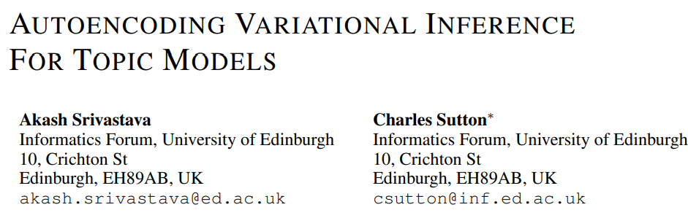
ICLR 2017

Slide 16
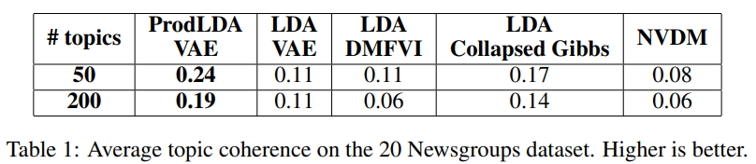
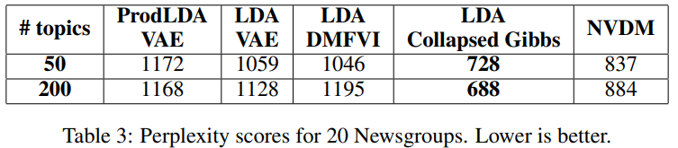
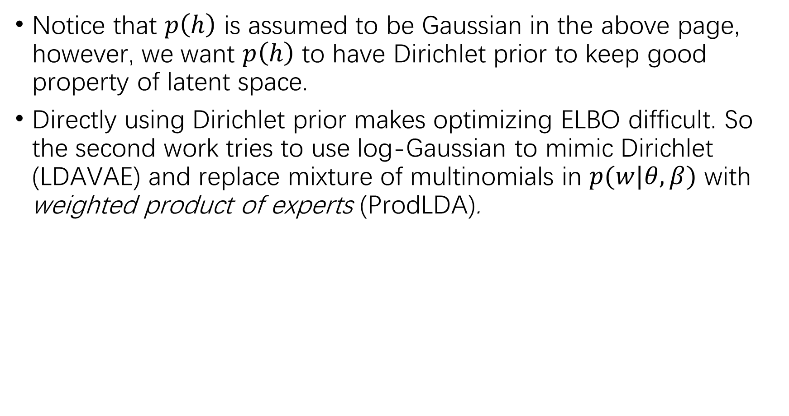
Notice that $p\left(h\right)$ is assumed to be Gaussian in the above page, however, we want $p\left(h\right)$ to have Dirichlet prior to keep good property of latent space.
Directly using Dirichlet prior makes optimizing ELBO difficult. So the second work tries to use log-Gaussian to mimic Dirichlet (LDAVAE) and replace mixture of multinomials in $p(w|θ,β)$ with weighted product of experts (ProdLDA).

Slide 17
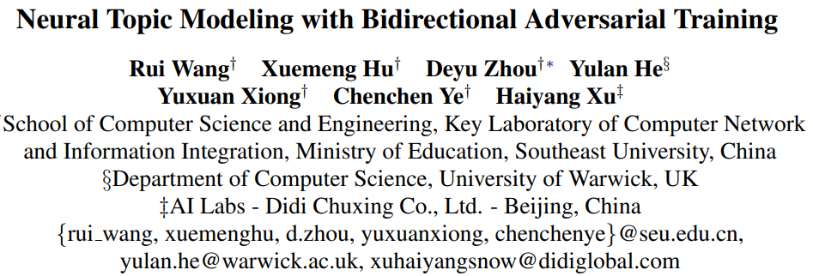
GAN
ACL 2020

Slide 18
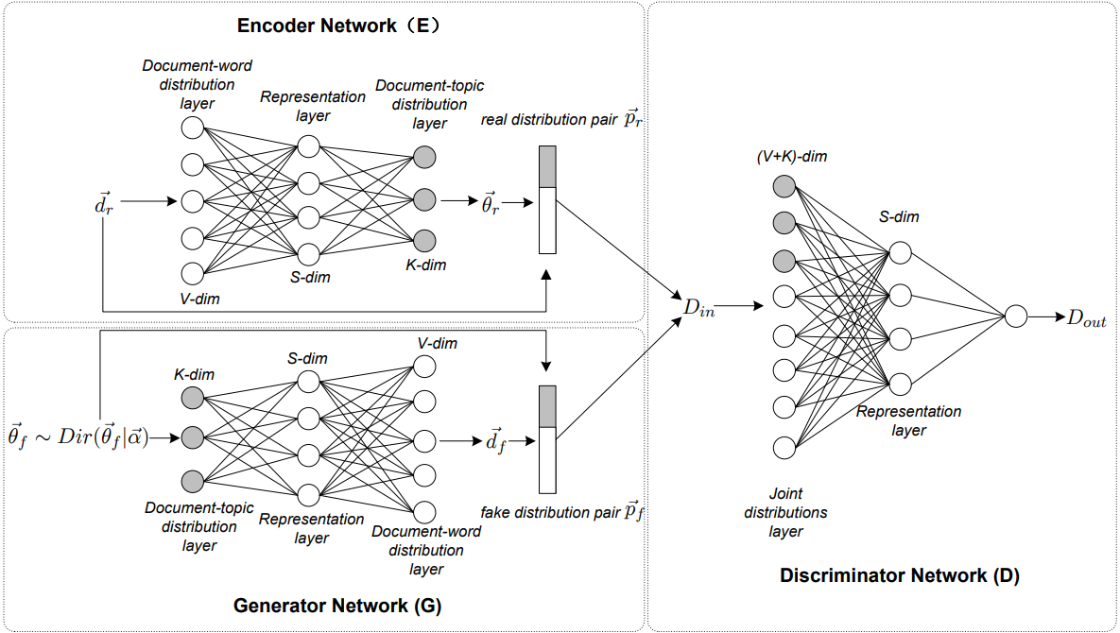
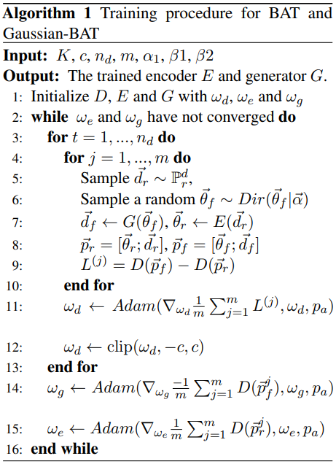
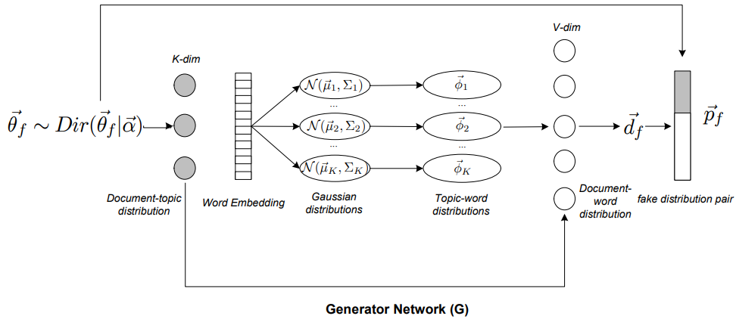
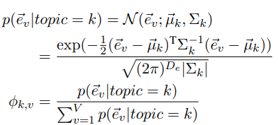


Slide 19
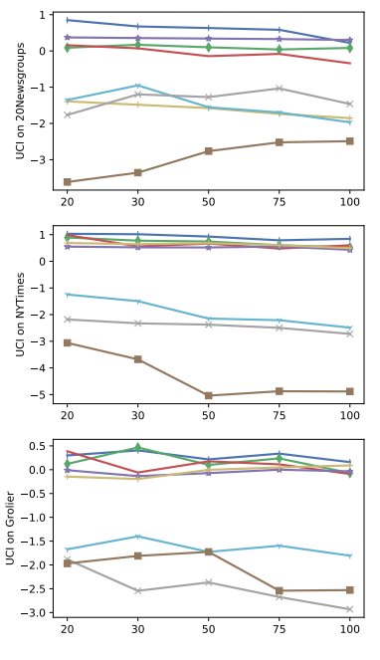
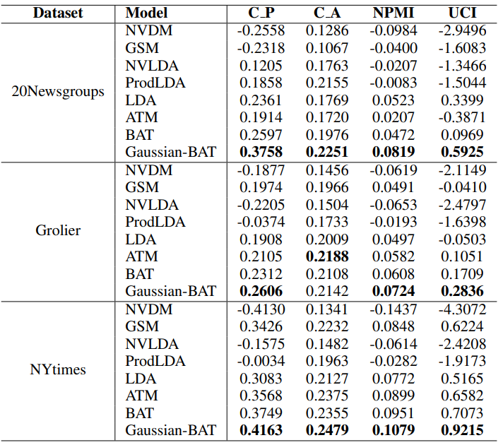

Slide 20
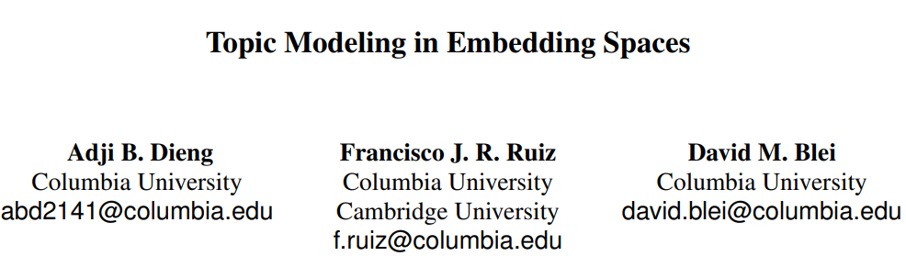
Combine word embedding
ACL 2020

Slide 21
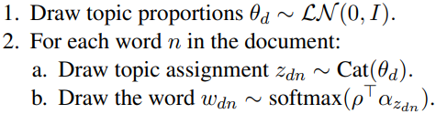

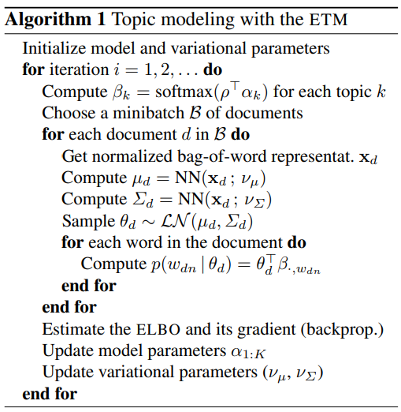
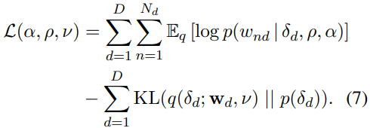

Given word embedding matrix $ρ∈ℝ^{N×L}$, represent each topic as a point in the same latent space: $a∈ℝ^{K×L}$.
The likelihood of the corpus is $ℒ\left(a,ρ\right)=\sum_{d∈D}{log⁡(p(w_{d}|a,ρ))}$.
$p\left(w_{d} | a,ρ\right)=∫p\left(δ_{d}\right)\prod_{n=1}^{N_{d}}{p\left(w_{dn} | δ_{d},a,ρ\right)}dδ_{d}$
$p\left(w_{dn} | δ_{d},a,ρ\right)=\sum_{k=1}^{K}{θ_{dk}×softmax\left(ρ^{T}a_{k}\right)}|w_{d_{n}}$
Use Variational Inference to maximize the ELBO:

Slide 22
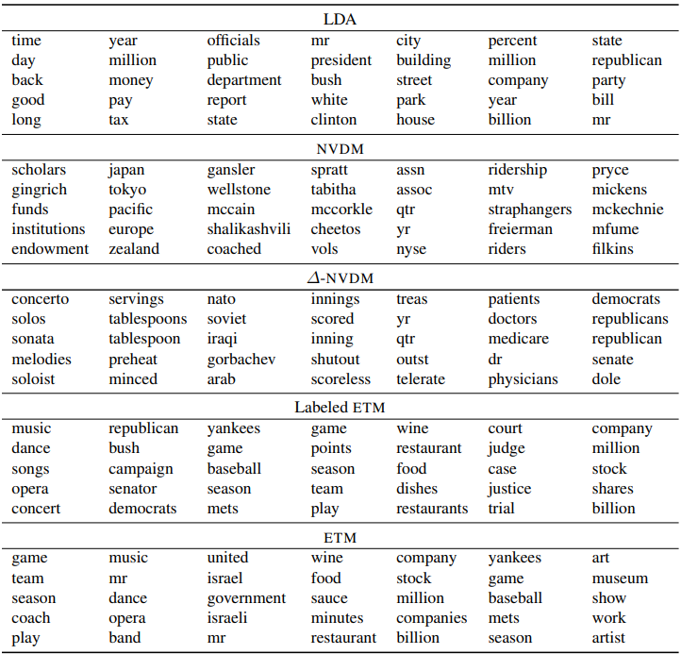

Slide 23
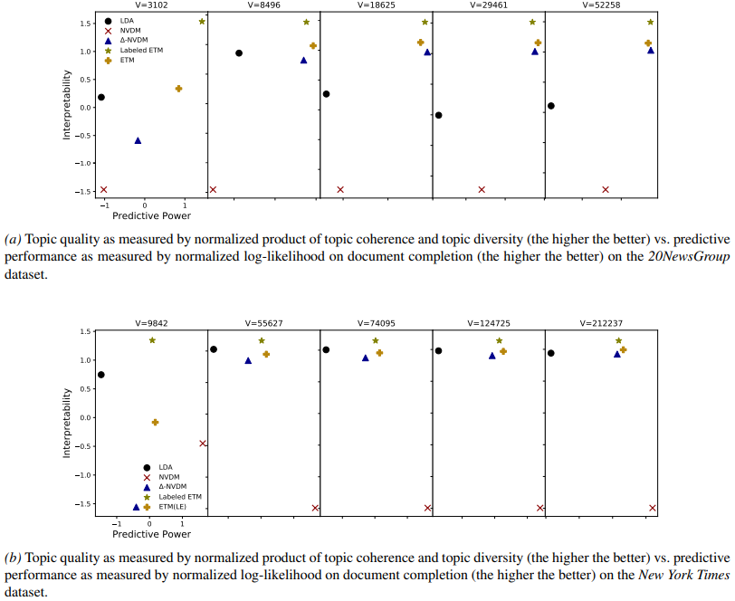
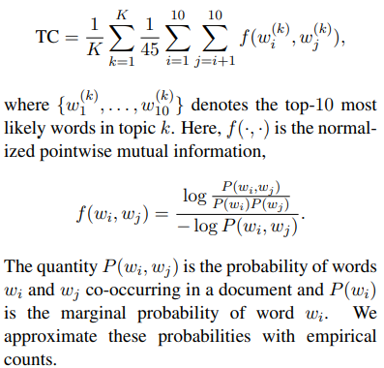
Topic Coherence
Document Completion Task
Divide each test document into two sets of words;
The first half is fed to the encoder for a topic proportion;
Use this topic proportion to generate the second set of words and compute likelihood.

